Slide 1
fLuOrEsCeNt DeTeCtIoN mEtHoD: BlOoD
Blue Team
Austin Hartman, Chelsea Wright, Diamond Cook, & Josh Doughtie

Slide 2
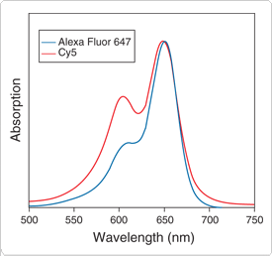
#1: Describe the excitation & emission spectra of the target
Optimum response of Phenylalanine, Tyrosine and internal standard was observed when the excitation and emission wavelengths were set at 260 and 282 nm, respectively. The amount of Phe and Tyr was quantified from a peak area ratio of Phe orTyr/internal standard using Clarity chromatography software (DataApex, Prague, Czech Republic)

Slide 3
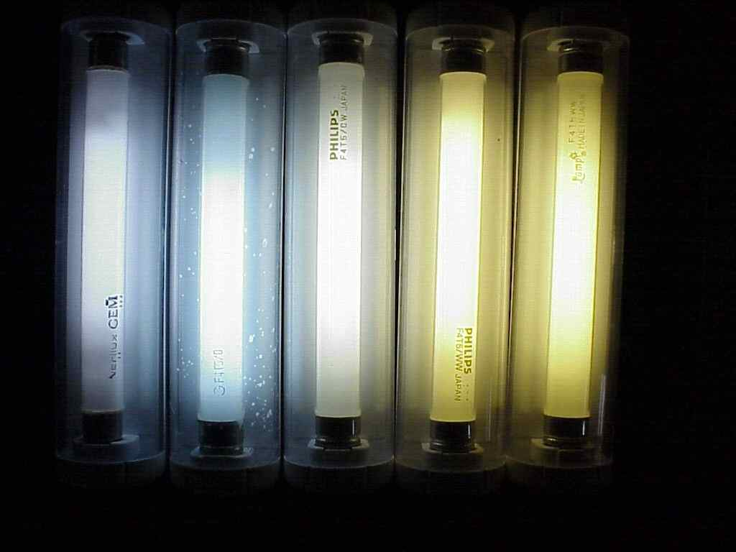
#2. Describe the light source used to excite the target and the detector used
By using a High-performance liquid Chromatograph, along with a solvent delivery system, auto sampler, column oven, RF 10Axl fluorescence detector and SLC-10Avp system controller; researchers were able to excite the Phenylalanine, and Tyrosine solutions.
Data was collected digitally with Clarity chromatography software.
The concentrations of Phenylalanine and Tyrosine in the samples were determined from the calibration curve (R. Kand’ár∗, P. ˇZáková).
In layman’s terms: lasers are used the light source.

Slide 4
#3. Provide an example of the output
An HPLC chromatogram of Phe (74.8_mol/L) and Tyr (40.9_mol/L) in a
dried blood sample. Tyr (3.2 min), Phe (6.0 min), N-methyl-Phe – internal standard
(6.7 min). HPLC conditions: an isocratic elution (mobile phase: 5% ethanol in
deionized water); stationary phase were a column LiChroCART 125mm×4mmi.d.,
Purospher STAR RP-18e, 5_m and a guard column LiChroCART 4mm×4mm i.d.,
Purospher STAR RP-18e, 5_m (Merck KgaA, Darmstadt, Germany). The flow rate
was kept constant at 0.5 mL/min, the separation ran at 37 ◦C and Phe, Tyr, and Nmethyl-
Phe were monitored at excitation and emission wavelengths of 260 and
282 nm, respectively.

Slide 5

#4. Describe any problems or need to optimize detection (interferences?)
From what has been read and researched, there are no reported major flaws to this fluorescent detection method.
This article and others that were looked at to verify flaws, never stated there were any interferences.

Slide 6

#5. Describe how it is used in forensic science laboratories.
HPLC with fluorescence is used in Forensic toxicology. Forensic labs use this method to detect drugs in the hair and blood, the most common group are methamphetamines. They use fluorescent reagents, such as 4-(4,5-diphenyl-1H-imidazol-2-yl)benzoyl chloride or DIB-CL for short, which react with compounds having a primary or secondary amino group and phenol group. Unlike other types of drug detection techniques (I.e gas chromatography), HPLC with fluorescence only require a small amount of blood or plasma in order to detect.
Other sources:
Http://onlinelibrary.wiley.com/doi/10.1002/bmc.716/pdf

Slide 7
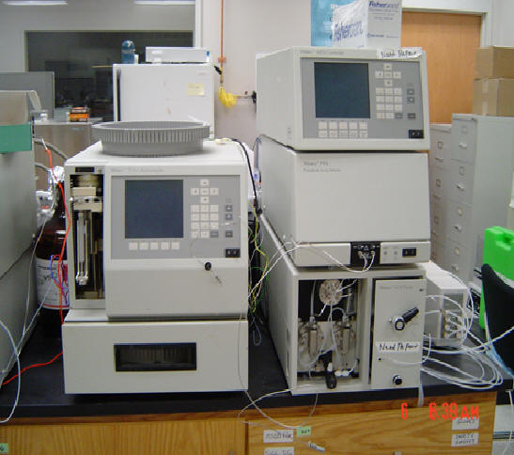
#6. Describe the instruments used in your applications
Liquid Chromatograph: Separates mixture of compounds, it is used to identify, quantify, and purify the individual components of a mixture.

Slide 8
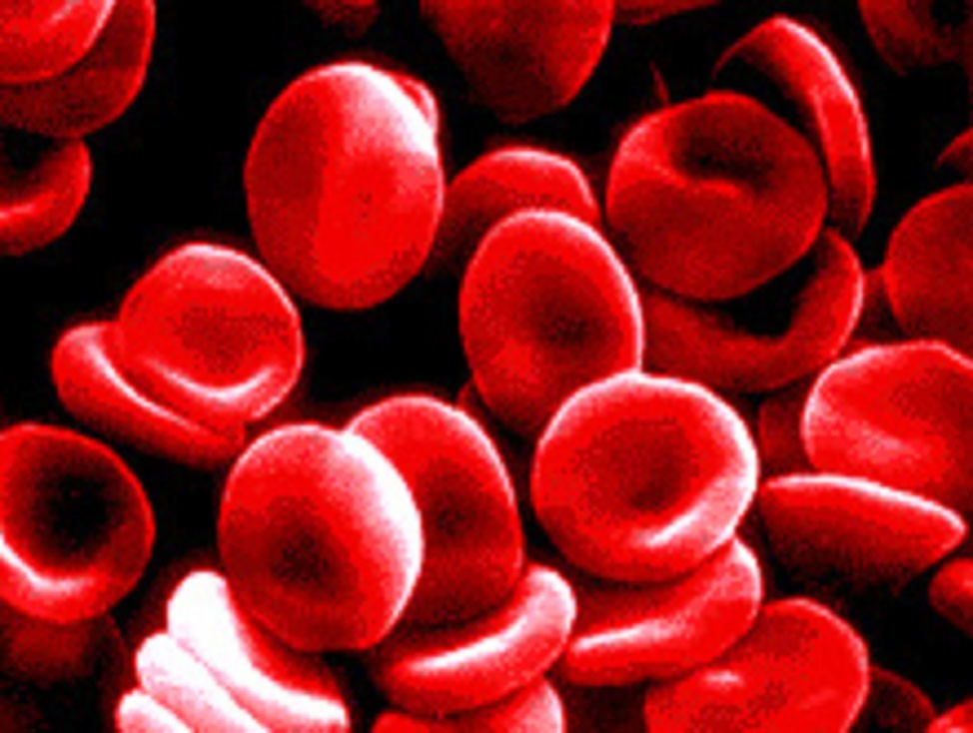
Scholarly Article
http://www.sciencedirect.com.libaccess.sjlibrary.org/science?_ob=ArticleURL&_udi=B6X0P-4XDD06H-3&_user=521825&_coverDate=11/15/2009&_rdoc=1&_fmt=high&_orig=search&_origin=search&_sort=d&_docanchor=&view=c&_acct=C000059578&_version=1&_urlVersion=0&_userid=521825&md5=848d6a5eeec7876ac5703023883ee6fa&searchtype=a

